Slide 1

Beyond the Engineering Design Process
-- Business Planning and Market Prediction
Case Study:
Sonar Panel Capacity Optimization Using
Monte Carlo Simulation
Dr. Yinong Chen

Slide 2
Simulation Beyond the Engineering Design Process
Define
Problem and requirement
Research, Solution Ideas
Define
Alternative solutions
Modeling
Analysis
Simulation
Final Section
Decide the Course of Action
Implementation, testing, and evaluation
Simulation in market prediction
Simulation in Business Planning and Market Prediction

Slide 3
Engineering Models
Mathematical Models: Based on logical and quantitative relationships
  Deterministic Models: Predictable behavior, always give the same answer each time we run the model.
    Truth table for ALU design
    Finite state machine for circuit design and software design
  Stochastic Models: Element of chance built into model different unpredictable answer each time we run the model
    Coin flipping experiment
    Reliability model of computer hardware and software
    Monte Carlo Model for various applications

Slide 4
Mathematical Models for Simulation
Simulation Models
Deterministic Models
All data are assumed to be known with certainty
Probabilistic Models
Some data are described by probability distribution.
2D/3D Models in Graphic Design
Outputs (graphics) are decided by geometric data and/or math functions, e.g., game objects: moving animals, fire, water.
Simulation Models in Circuit Design
Outputs are decided by inputs only. e.g., Truth Table. Outputs are also decided by states, e.g., Finite State Machine.
Monte Carlo Simulation
A sampling experiment to estimate the distribution of an outcome variable depending on random input variables, e.g., profit projection, stock portfolio.
System Simulation
An experiment used to describe sequences of random events, e.g., inventory, queuing, and manufacturing process.

Slide 5
Monte Carlo Simulation
Monte Carlo Simulation is a probabilistic/stochastic simulation technique.
It has been used in a wide variety of applications:
  Stock market forecasting
  Business and Econometrics Systems, such as supply chain
  Energy generation and planning
  Computer system and VLSI design
  Computer network capacity planning
  Traffic flow and control
  Nuclear reactor design
  Radiation cancer therapy
  Stellar evolution
  Oil well exploration
  … and many more

Slide 6
Case Narrative
Julia pays for her home electricity from the power grid (electricity outlets) at the rate of 24¢/kwh
She wants to install the solar panel for cost saving. She was quoted:
  The solar panel-generated electricity cost: 15¢/kwh.
  She can install solar panel at different capacity ranging from 2,000kwh to 20,000kwh/year.
  She must decide the installation capacity up in front, e.g., 6000kwh.
  She can sell the unused electricity back to the power grid at 5¢/kwh
Her annual use pattern in the past years are always between 4,000kwh and 9,000kwh.
What capacity should Julia install, in order to maximize the benefit/saving?
4,000kwh, 5,000, 6,000, 7,000, 8,000, or 9,000kwh?

Slide 7
Sample Calculation on Given Capacity
Assuming Julia will use between 4,000 and 9,000kwh
If she installs the capacity of 4,000kwh/year, she will save
(0.24-0.15)*4000 = $360/year
If she installs the capacity of 9,000kwh/year
  If she indeed uses 9000kwh, she will save
  (0.24-0.15)*9000 = $810/year
  If she uses 4000kwh only, she actually pay:
  0.15*9000 - 0.05*5000 = 1350 – 250 = $1100.
  The cost without solar: 0.24*4000 = $960. She loses $140
If she installs the capacity of 6,000kwh/year
  If she uses 9000kwh, she will pay
  0.15*6000 - 0.05*3000 = 900 - 150= $750/year
  The cost without solar: 0.24*6000 = $1440. She saves $690
  If she uses only 4000kwh, she actually pay:
  0.15*4000 - 0.05*5000 = 600 – 250 = $350.
  The cost without solar: 0.24*4000 = $960. She saves $610

Slide 8
Elements of a Math Model
Boundaries: Pre-conditions and assumptions that are assumed to be true, e.g., the system will be operated in the temperature between 32 and 125 degree.
Parameters: The dimensions that impact the system behaviors.
Values or range of values for each parameter, i.e., state of robot, can have values forward, turning left, turning right, backward.
Constraints/Relationships/Solution: Use formulas/functions that link variables together to represent the solution to the problem.

Slide 9
Elements of Monte Carlo Simulation Model
The revenue and cost
The demand D (uncontrollable and probabilistic)
The purchased capacity C (the decision variable to be decided)
The goal of the simulation is to find the most-likely maximum value of the net profit or saving (or minimize the cost)
Most-likely means at the highest probability

Slide 10
Relationship among Model Elements
The revenue and cost
  Solar Cost: S = $15¢/kwh
  Grid Cost: G = 24¢/kwh
  Buyback Price: B = 5¢/kwh
The demand D
  between 4000 and 9000
The purchased capacity C (the decision variable)
  4000, 5000, 6000, 7000, 8000, 9000
The model:
Saving = cost without solar – cost with solar
24C – 15C if D >= C
24D – (15C – 5(C – D)) if D < C
  Saving =

Slide 11
How Do We Solve the Model with Multiple Variables
The Monte Carlo Model:
24C – 15C if D >= C
24D – (15C – 5(C – D)) if D < C
  Saving =
Where C is the purchased capacity
D is the demand, which is kind of random
The goal is to maximize “Saving” by
Choose D: Use a random generator to generate a random number between typical use patterns, e.g., between 4000 and 9000.
Choose C to maximize Saving in probabilistic sense

Slide 12

Full Calculation of Dollar Saving for
Different Capacities and Demands
Install Capacity
D/C (kwh) | 4000 | 5000 | 6000 | 7000 | 8000 | 9000
4000 | 360 | 260 | 160 | 60 | -40 | -140
5000 | 360 | 450 | 350 | 250 | 150 | 50
6000 | 360 | 450 | 540 | 440 | 340 | 240
7000 | 360 | 450 | 540 | 630 | 530 | 430
8000 | 360 | 450 | 540 | 630 | 720 | 620
9000 | 360 | 450 | 540 | 630 | 720 | 810
Demand
What capacity should Julia install, in order to maximize the benefit?

Slide 13

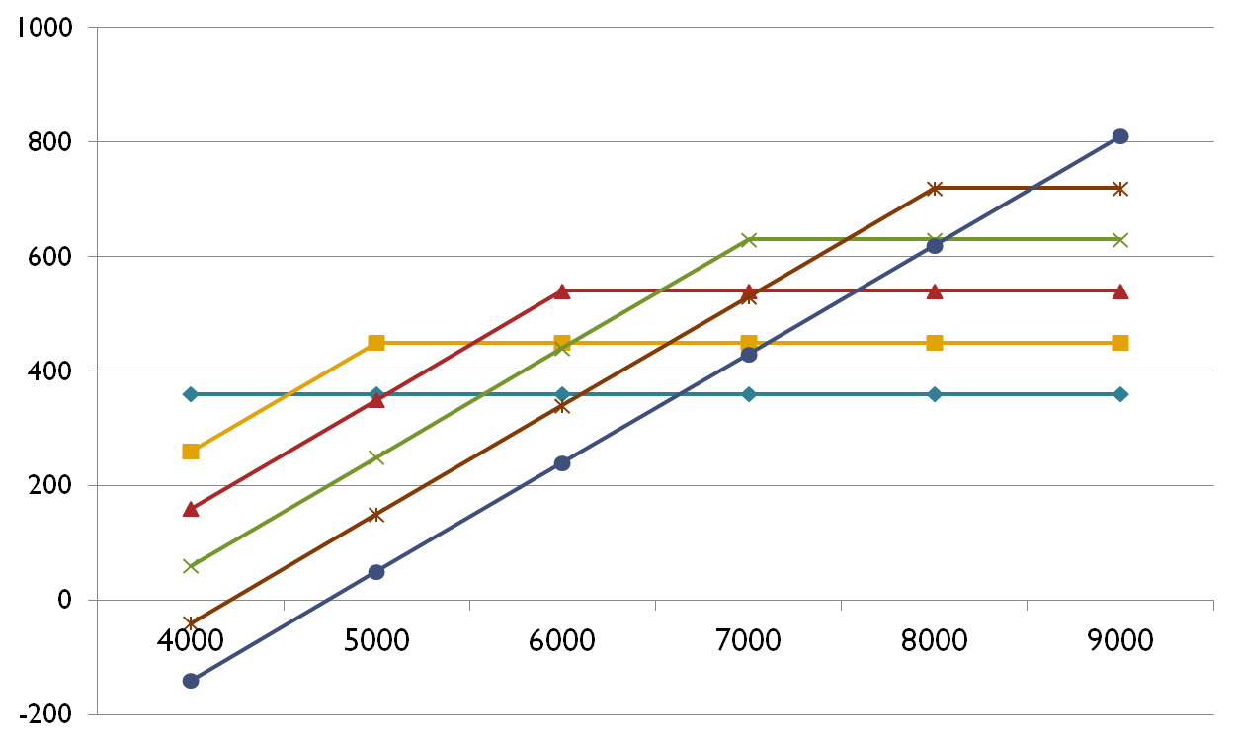
Dollar Saving for the Capacities and Demands
Installed Capacity
9000
8000
7000
6000
Saving $Amount
5000
4000
Demand
Still unanswered: What capacity should Julia install, in order to maximize the benefit?

Slide 14


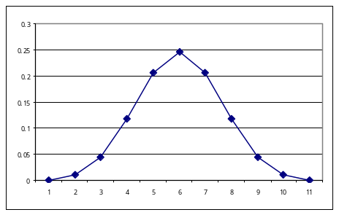
Decide the Values of the Random Variable D: Demand
Trace the usage History
Demand (kwh) | Equal Frequency | Weighted Frequency
4000 | 16.67% | 10%
5000 | 16.67% | 20%
6000 | 16.67% | 20%
7000 | 16.67% | 20%
8000 | 16.67% | 20%
9000 | 16.67% | 10%

Slide 15
Optimized Saving Found based on the
Monte Carlo Experiment
Install Capacity
D / C | 4000 | 5000 | 6000 | 7000 | 8000 | 9000
4000 | 360 | 260 | 160 | 60 | -40 | -140
5000 | 360 | 450 | 350 | 250 | 150 | 50
6000 | 360 | 450 | 540 | 440 | 340 | 240
7000 | 360 | 450 | 540 | 630 | 530 | 430
8000 | 360 | 450 | 540 | 630 | 720 | 620
9000 | 360 | 450 | 540 | 630 | 720 | 810
Simlpe Avg | 360 | 418 | 445 | 440 | 403 | 335
Weighted Agv | 360 | 447 | 511 | 535 | 517 | 459
Demand

Slide 16
Solving mathematical Models Using Spreadsheet
Excel is a useful tool for solving mathematical models
  Tables, diagrams, and charts
  Mathematical and logical functions
  Programming capacity
Develop the Excel model using embedded math functions
Generate random values for each probabilistic variable according to its probability distribution and apply the outcomes to the model
Compute summary statistics and collect output data in a frequency distribution or histogram for analysis.

Slide 17
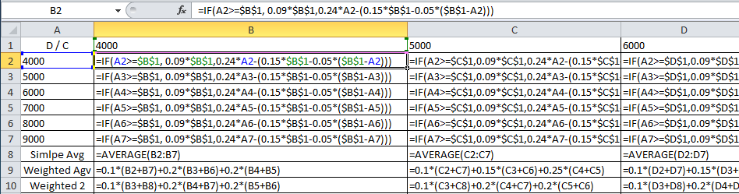
1. Create the Monte Carlo Model in Excel
24C – 15C if D >= C
24D – (15C – 5(C – D)) if D < C
  Saving =
To see the formula: Press CTRL and ` (grave accent) or ~ (tilde)

Slide 18
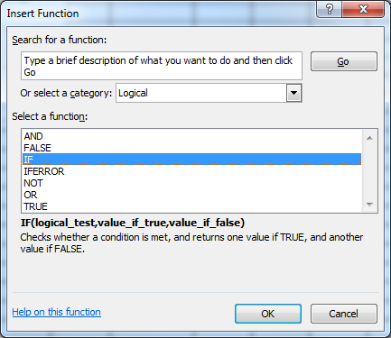
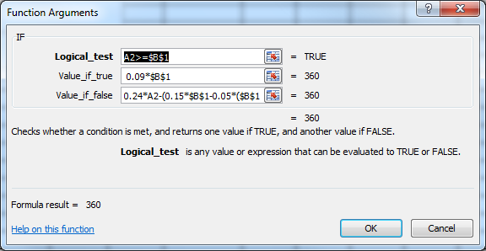
Conditional Statement in Excel
IF statement
  = IF(logic statement, then this happens, else this happens)
  Example
  =IF(B9<=10, “broken”, “working”),
  =IF(A2 >=B1, 0.09*B1, 0.24*A2)
Notes:
Comments
Logic statements are an easy way of passing information in Excel. This is just a quick explanation of how to use them in Excel. There are examples in the iterate model as well.
Start Time
1:15
Stop Time
1:30

Slide 19
Logical Functions in Excel
AND statement
  = AND(logic 1, logic 2) : both items must be true
  example, =IF(AND(B9<10, C4>=1), “broken”, “working”)
OR statement
  = OR(logic 1, logic 2) : either item must be true
  example, =IF(OR(B9<10, C4>=1) , B9+4, 0)
NOT statement
  = NOT(logic 1) : Turn true into false
  example, =IF(NOT(B9>=10), “working”)
Notes:
Comments
Logic statements are an easy way of passing information in Excel. This is just a quick explanation of how to use them in Excel. There are examples in the iterate model as well.
Start Time
1:15
Stop Time
1:30

Slide 20
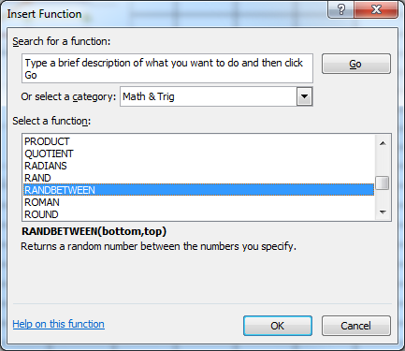
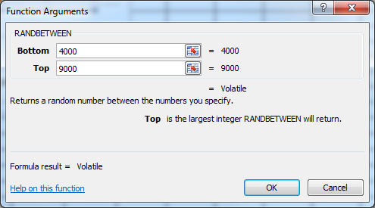
2. Generate Random Numbers to Simulate the Demand
From Excel menu bar, select Formulas → Insert Functions
Choose Math & Trig and RANDBETWEEN
You can choose the random number falls between 4000 and 9000, which directly create a use scenario. You can also use the ROUND function to round the number to 1000.
=RANDBETWEEN(4000,9000) | =ROUND(H6,-3)

Slide 21
Random Function in Excel
In Excel, RAND() is used to implement a “random number generator”.
Type into a cell: = RAND()
  produces a number between 0 and 1; any number can occur at the same frequency.
Repeat several times. What do you get?
Histograms can be used to plot the number of times each number occurred.
Notes:
Comments
This is a build slide. Build as the students perform each task or answer each question.
We will be teaching new Excel tools or functions with each model. This is the first one we want them to learn and use in the appropriate models.

Slide 22
Round Functions in Excel
There are three round functions:
  ROUND(x, 0), ROUND(x, 1), ROUND(x, -1)
  ROUNDUP(x, 0)
  ROUNDDOWN(x, 0)
What function will generate data between [0, 99]?
  ROUNDUP(RAND()*100,0))
  ROUND(RAND()*100,0))
  ROUNDDOWN(RAND()*100,0))
Notes:
Comments
This is a build slide. Build as the students perform each task or answer each question.
We will be teaching new Excel tools or functions with each model. This is the first one we want them to learn and use in the appropriate models.

Slide 23
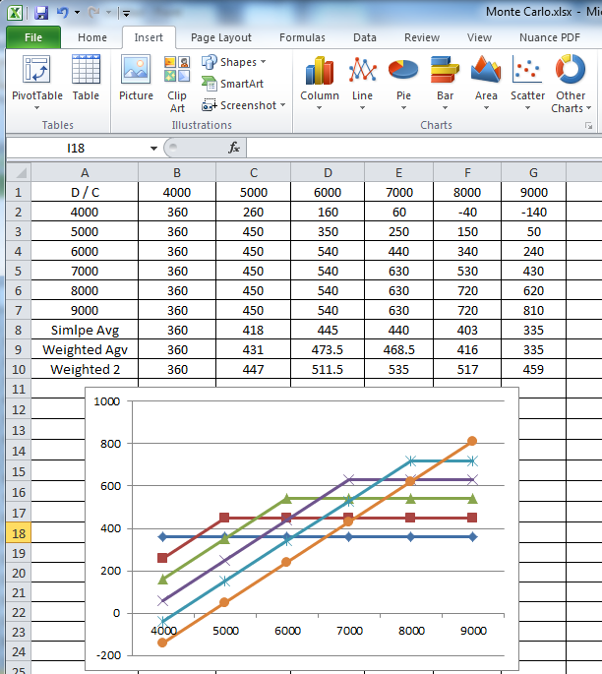
3. Perform Analysis

